Slide 1



Presentation on HTML to PDF API
Author: Sekar M
Created with Pi

Slide 2

CONTENTS
1. Introduction to HTML to PDF API
2. How to Use the HTML to PDF API
3. Conclusion

Slide 3

01
Introduction to HTML to PDF API

Slide 4
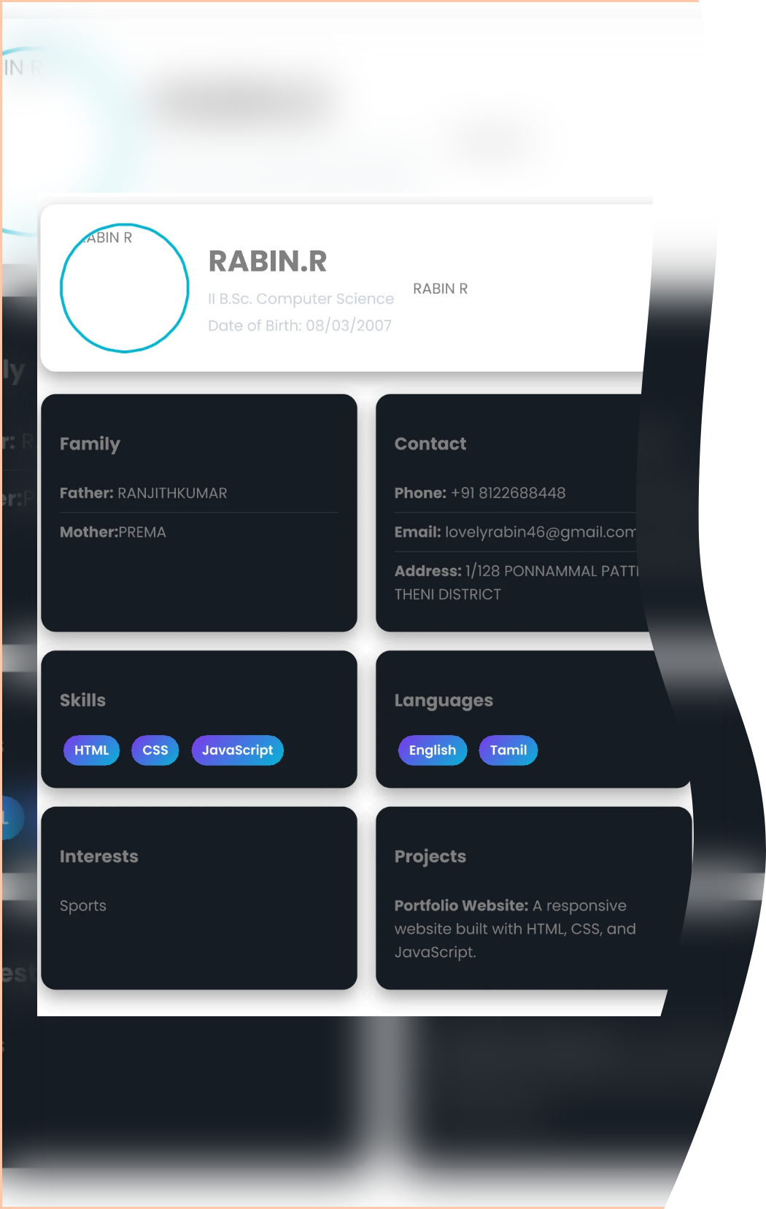
Overview
The HTML to PDF API is designed for developers to easily convert web pages into PDF documents.
Feature | Description
Developer-friendly | Easy to integrate with applications
High quality | Produces professional PDFs
Customizable options | Set page size, margins, etc.

Slide 5







Benefits of Using the API
1
Ease of integration
The API can be seamlessly connected to existing applications.
2
Time-saving
Automated process helps in generating PDFs quickly.
3
Flexibility
Offers customizable options for different PDF layouts.

Slide 6

02
How to Use the HTML to PDF API

Slide 7






Getting Started
1
2
Setup
Making Your First Request
• Create an account on the API provider's website.
• Use the API endpoint to send a request with the URL of the webpage you want to convert.
• Obtain your API key for authentication.
• Specify any additional options required for the PDF generation.

Slide 8

Advanced Features
Batch processing: Convert multiple pages in a single request.
Maintenance of original design: Ensures that the layout of web pages is preserved in the PDF.

Slide 9

03
Conclusion

Slide 10

Conclusion
The HTML to PDF API simplifies the process of converting web content to PDF, making it an essential tool for developers.

Slide 11

Thank You

